Slide 1

ORAL COMMUNICATION
CAPSTONE PROJECT
Quick reminder about the deadlines

Slide 2



PROJECT DEADLINES
We are here!
DEADLINE-1
SPEECH STRATEGY
Strategy
MAY 12TH
What is the topic of the presentation?
What is your objective?
Who is your audience?
What is your key message?
DEADLINE-2
SPEECH CONTENT
Structure
Find your main arguments, yours facts
Organize your speech using a pyramid
Persuasive language
Strong opening
Topic transitions
Strong closing
MAY 22ND
Slides
MAY 29TH
DEADLINE-3
SPEECH SLIDES
Slides during MS OFFICE course
DEADLINE-4
VIDEO
Video
JUN 04TH
Your 2-min video
JUN 05-09?
Present to JURY

Slide 3

ORAL COMMUNICATION AGENDA
4
Use the right body language
We are here!
3
Make the communication interesting
2
Define the communication content
1
Define the communication strategy
Notes:
FOR TRAINERS
The last step is to use body language, story telling to make sure your audience is not falling asleep or tuning out when you talk.
Note : creating efficient slides to support your presentation will be explained in the MS Office course

Slide 4

OBJECTIVES FOR TODAY
Understand the characteristics of the 3 elements of a presentation
Learn to grab your audience attention during the opening
Understand how create an effective body with transitions
Learn about the golden rules of a great speech

Slide 5



REVIEW
10 MINS
What did you learn from the videos?
2 students come to explain their understanding

Slide 6

REVIEW
5 MINS
What are the key elements for an effective opening?

Slide 7
EXPLAIN
What are the 5 important steps of an effective opening?
10 MINS
1
Grad the audience attention = the hook
E.g. Facts, quote
2
Introduce yourself
3
Introduce purpose and subject = what and why?
E.g. I am going to talk about the SEA Games because they are taking place this year in Cambodia.
4
Introduce your key message
E.g. I want to talk to explain to you why recycling is important.
5
Provide an overview/ structure of the body of your speech
E.g. I will 1st talk about…, then…, finally …

Slide 8






EXPLAIN
Grab your audience attention with hooks!
10 MINS
Interesting fact(s)
Quote(s)
Example(s)
Question(s)
Short story
Notes:
TRAINER
1- In group
2 – 1 group present

Slide 9
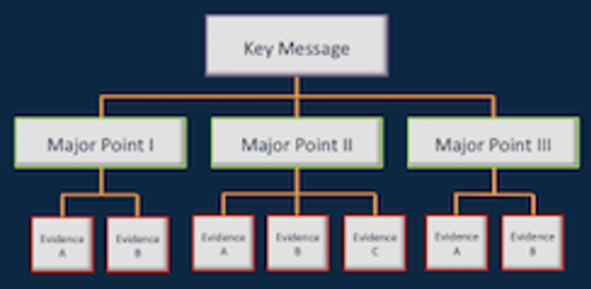


EXPLAIN
What’s an effective body?
10 MINS
Your communication pyramid is used in the body
You should spend equal time on each major point
Use transitions to guide your audience and set their expectations for the following part.
Transition
Transition

Slide 10

EXPLAIN
Guide your audience
10 MINS
OPENING
BODY
ENDING
Overview
Transitions
However, therefore, on the other hand, additionally, previously
Frame the information
“I will explain that with three facts.”
Tie the hook
“As I was saying at the beginning of my presentation…”
Summarize key message and key points
“We have seen that…”
Thank your audience
“I’ll present you 3 main ideas.”

Slide 11

EXPLAIN
The 5 Golden Rules
10 MINS
KNOW YOUR
AUDIENCE
REAL-WORLD
EXAMPLES
CLEAR
OBJECTIVE
KEEP IT
SIMPLE
LESS IS MORE
What does the audience already know about the topic?
Will the audience understand technical vocabulary?
Don’t give too much information, focus only on your key message
During closing, you can include a slide that tells them where to go to get extra information
Strong examples are more persuasive than piles of numbers
What do you want your audience to do as a result of the presentation?
Simple graphics are a great way to explain technical concepts

Slide 12

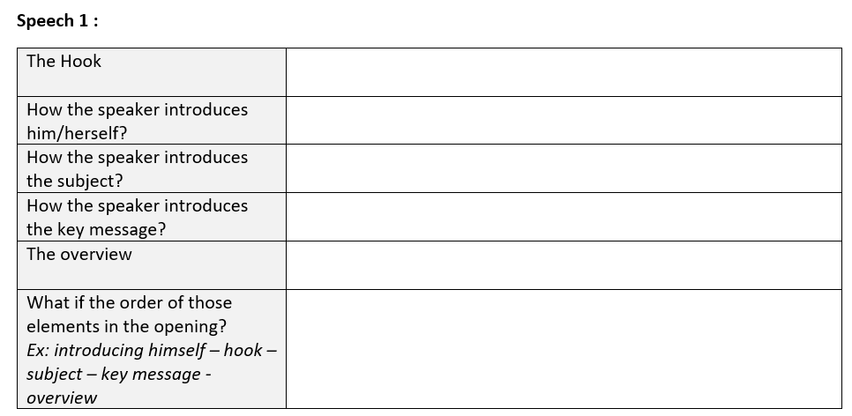
ACTIVITY 1
Analyze openings
90 MINS
Opening 1
opening of the TED speech by Anthony Atala,
Watch from the beginning until 1:23 min.
Opening 2
Understanding Embryonic Stem Cells Research Channel.
Scroll to 6:14 min., in the video. Watch until 7:01 min.
Opening 3
Hans Rosling: The best stats you’ve ever seen.
Watch from the beginning until 2:27 min.
1
2
3
CLASS PRESENTATION
AND DISCUSSION
(30 mins)
TO COMPLETE THIS ACTIVITY:
DEFINE STEPS
INDIVIDUAL
(10 mins x 3)
ANALYSE EACH OPENING
GROUP DISCUSSION
(10 mins x 3)

Slide 13
ACTIVITY 2
Find hooks!
20 MINS
Subject: The 32nd SEA Games
TO COMPLETE THIS ACTIVITY:
1
GROUP DISCUSSION
(10 mins)
2
CLASS PRESENTATION
(10 mins)

Slide 14
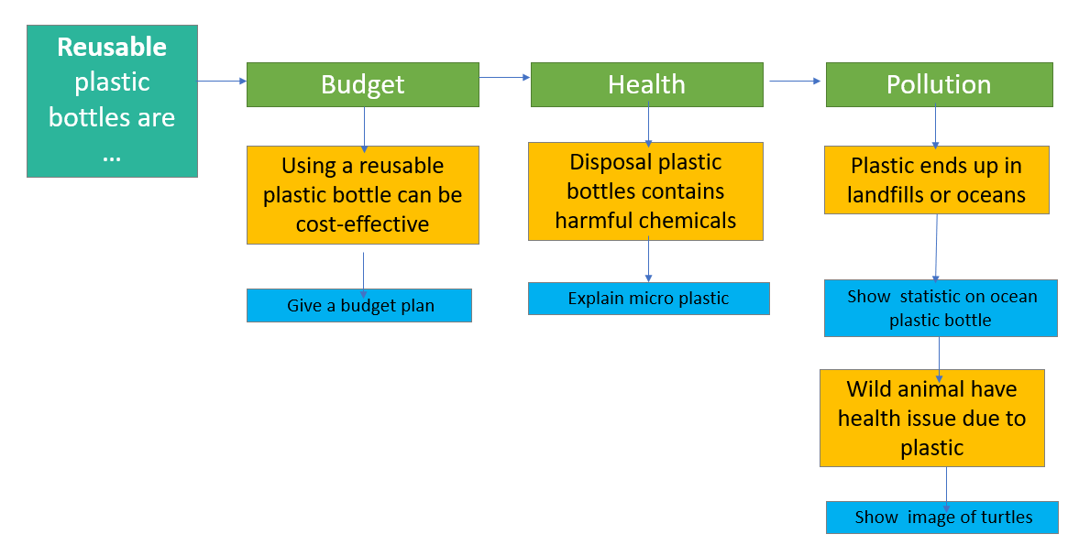
Where are the transitions?
ACTIVITY 3
15 MINS
?
?
?

Slide 15
Find transitions - Correction
CORRECTION
5 MINS
Now that we have seen the influence on the budget, we can go on analyze the impact on health.
We have seen the impact on human health, but what is the impact on the planet’s health? Let’s talk about pollution.
In addition, we know that wild animals have health issues due to plastic.

Slide 16
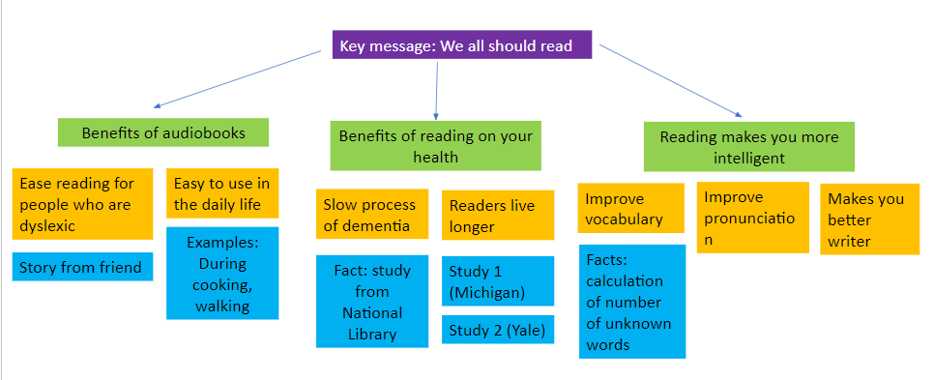
ACTIVITY
Find transitions!
20 MINS
?
?
?
?
?

Slide 17
ACTIVITY 4
Find transitions ! Correction
Reading is not only good for the health, it is good for the brain.
15 MINS
Now that it's clear that everyone could enjoy a book, let’s focus on the benefits of reading for health.
In addition, audio books can be used in the daily life.
Other researches have shown that readers live longer.
After Michigan University, Yale published another study.

Slide 18
ACTIVITY 5
You will present an informative speech about the SEA games. Here is the pyramid of your speech.
Create the opening, find good transitions and create the closing
20 MINS
Subject: The 32nd SEA Games
History
2023 SEA Games
Benefits for Cambodia
Important dates
Participants
Locations
New sports
Economy
Popularity among the population
Dates
Countries
Facts
Facts
Budget
Story

